Slide 1
National Differences in Communication Styles
International Communication Styles Conference
Krosno, Poland, 14 October 2013
Geert Hofstede

Slide 2
Communication in the ICT era
We live in the age of Information and Communication Technology
“ICT” refers to the “hardware” of electronic communication, which is more or less the same across the world
Communication styles are the “software” of human communication; they depend on the people involved, and on their environment
The conference programme shows an impressive variety of styles
The way we communicate depends on, and maintains our cultures
Human cultures differ for many reasons; this presentation will focus on the influence of the country where we were born and raised

Slide 3
Three meanings of “culture”
Originally: tilling the soil, cultivation
Training or refining of the mind: civilization
Collective ways of thinking, feeling and acting: “collective programming of the mind distinguishing the members of one group or category* of people from another”
*) e.g. society (national or regional), religion, occupation, organization, gender

Slide 4
Levels of mental programming
symbols
heroes
rituals
values
invisible
practicesvisible

Slide 5
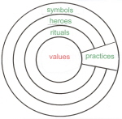
values
Core of our mental programming.
Mostly unconscious : in our guts, not in our heads
Values are strong emotions with a - and a + such as: evil-good, abnormal-normal, ugly-beautiful, dangerous-safe, immoral-moral, indecent-decent, unnatural-natural, dirty-clean, paradoxical-logical, irrational-rational
What is rational is a matter of values

Slide 6
Unconscious values are acquired in our childhood
We humans are born incompletely programmed
During the first 10 years of our lives we have a physiologically determined ability for absorbing complex information: additional programming
This programming is provided by our social environment and includes all our basic values
It also includes learning languages accent-free
After age 10, basic values don’t change – not even if we migrate to another country
And if we learn new languages, we keep an accent

Slide 7
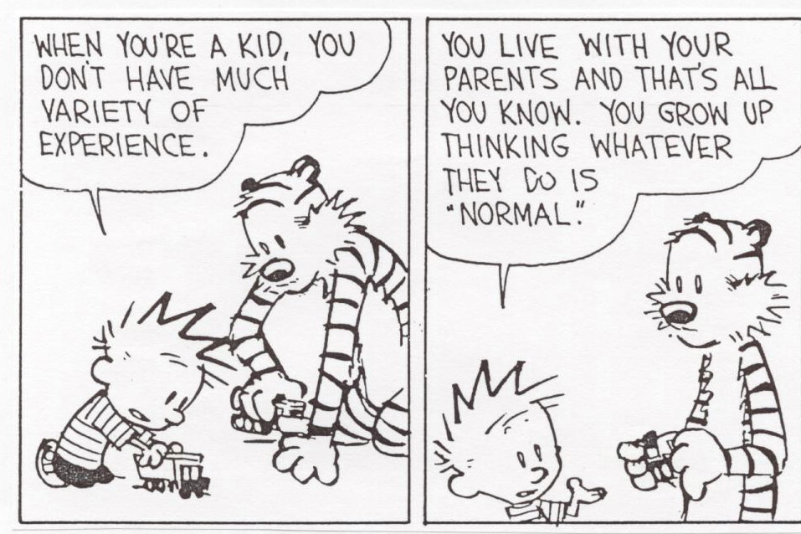

Slide 8
Practices are learned and unlearned throughout life, nearly always conscious
Similar practices (symbols, heroes and rituals) can be learned by persons with very different values
Practice learning is also provided by our social environment
Working together means sharing practices, not necessarily sharing values

Slide 9
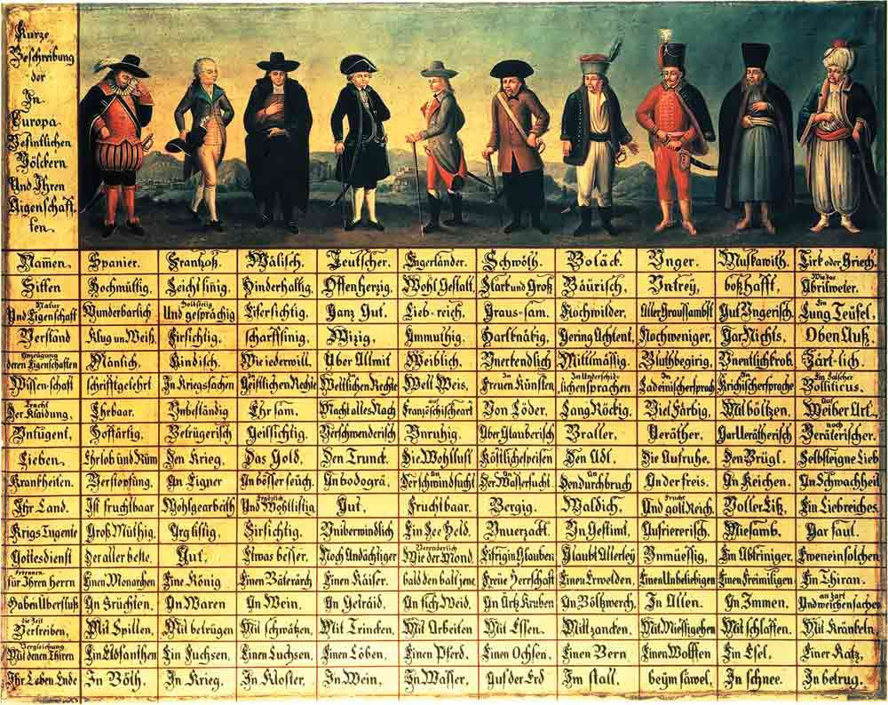
Comparing national cultures: Völkertafel, Steiermark 1725: Stereotypes
Notes:
Namen, Wissen, Natur und Eigenschaft, Verstand, Erzeugung deren Eigenschaften, Wissenschaft, Tracht der Kleidung, Untügent, Lieben, Krankheiten, Ihr Land, Krigs Tugende, Gottesdienst, Namen für Ihren Herren, Haben Überfluss, Ihr Zeit Vertreiben, Vergleichung mit denedn Thiren, Ihr Lebens Ende
Spanier, Fransoss, Italisch, Teutscher, Engerlander, Schwöth, Polack, Unger, Muskawith, Tirk oder Griech

Slide 10
The dimension concept in studying the social world
Dimensions are a way of unpackaging complex realities into independent basic elements
Dimensions may be invented behind the desk, but have to be confirmed by statistical research
Their usefulness depends on their ability to relate to tangible facts and to predict actual behaviour
Societies can be given scores on dimensional scales
Research consists of relating scores to behaviour

Slide 11
Dimensions of national (societal) cultures, rooted in basic values (Hofstede, Hofstede & Minkov, 2010)
1. Dependence on others:
from Individualism to Collectivism
2. Handling inequality:
Power Distance, from large to small
3. Dealing with the unknown:
Uncertainty Avoidance, from strong to weak
4. Emotional gender roles, different or similar:
from Masculinity to Femininity
5. Time perspective:
from Long- to Short-Term Orientation
6. Dealing with natural drives:
from Indulgence to Restraint

Slide 12
Intra-cultural and inter-cultural communication
Most of this lecture will be about differences in communication styles within national societies (intra-cultural)
The last part will deal with communication between different national societies (inter-cultural)
Intra-cultural differences can be largely explained by differences in values, using the dimensions of national cultures as tools
Inter-cultural communication takes place between partners with often different values. Its success depends rather on practices and personalities

Slide 13
Dimensions relevant for communication styles
Individualism-Collectivism
Direct versus indirect communication
Long-/Short-Term Orientation
Dominance of literate vs oral communication
Degree of self-enhancement needs
Power Distance
Roles and language depend on relative position
Degree of newspaper reading
Uncertainty avoidance
Adoption of new media

Slide 14
Individualism-Collectivism and communication styles
Individualist
“I”, independent self
Unique personality
Direct, personal, verbal
Universalist, all are the same
Low context communication: everything should be explicit
A honest person speaks his/her mind
Active search for information in different media
Collectivist
“We”, interdependent self
Member of in-group
Indirect, visual, metaphorical
Particularist, ours and theirs
High context communication: many things are implicit
Harmony should be preserved, direct confrontations avoided
Heavy use of social media, word of mouth, passive search

Slide 15
Ind-Col score ranking for selected countries
individualist
USA, Australia
UK, Canada
Netherlands, Belgium
Hungary, Italy
Nordic countries
Baltic countries
German speaking countries
Poland, Czechia, Slovakia
Spain
India, Japan
Russia, Turkey, Greece
Brazil
Balkan countries
Islamic countries, Africa
China, East Asia
Spanish America
collectivist

Slide 16
Individualist model of interpersonal communication: linear processing
Sender
Encoding
Message
Medium
Decoding
Receiver
Feedback
Collectivist model (narrow exit, wide entrance): Harmony & empathy essential
Group
Context
Status
Situation
Non-verbal
signals
Group
Context
Status
Situation
Non-verbal
signals
Internal
Evaluation
process
Messages
Mind
reading
process
Exit
Entrance
Mutual ‘reading’ of non-verbal cues
Source: M. de Mooij, 2013

Slide 17
Direct and personal: USA
Indirect and emotional: Spain “Friday”

Slide 18
Long/Short-term Orientation and communication styles
Long-term Oriented
Patience, perseverance
Modesty, self-effacement
Adaptation, pragmatism
Learn from other countries
Literate cultures
Thrift: sparing with resources
Low use of facebook, few friends in social media
Short-term Oriented
Need for instant reaction
Boasting, self-enhancement
Sacrosanct traditions
Proud of my country
Oral cultures
Spending and borrowing
High use of facebook, many friends in social media

Slide 19
Long/Short Term ranking for selected countries
long-term oriented
Korea, Taiwan
Japan, China
Germany, Switzerland
Baltic countries
Ukraine, Russia
East-European countries
Belgium, Netherlands
France, Italy
Nordic countries
UK, India, Pakistan
Spain, Portugal, Turkey, Greece
Brazil
USA, Australia
Spanish America, Africa
Islamic countries
short-term oriented

Slide 20
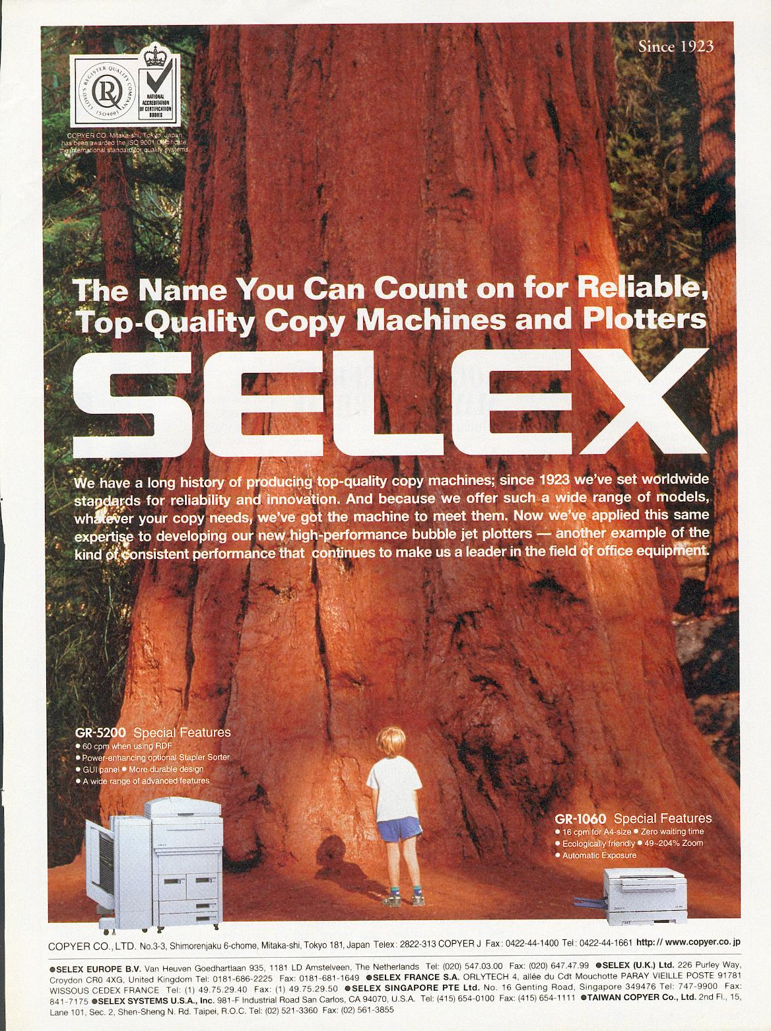
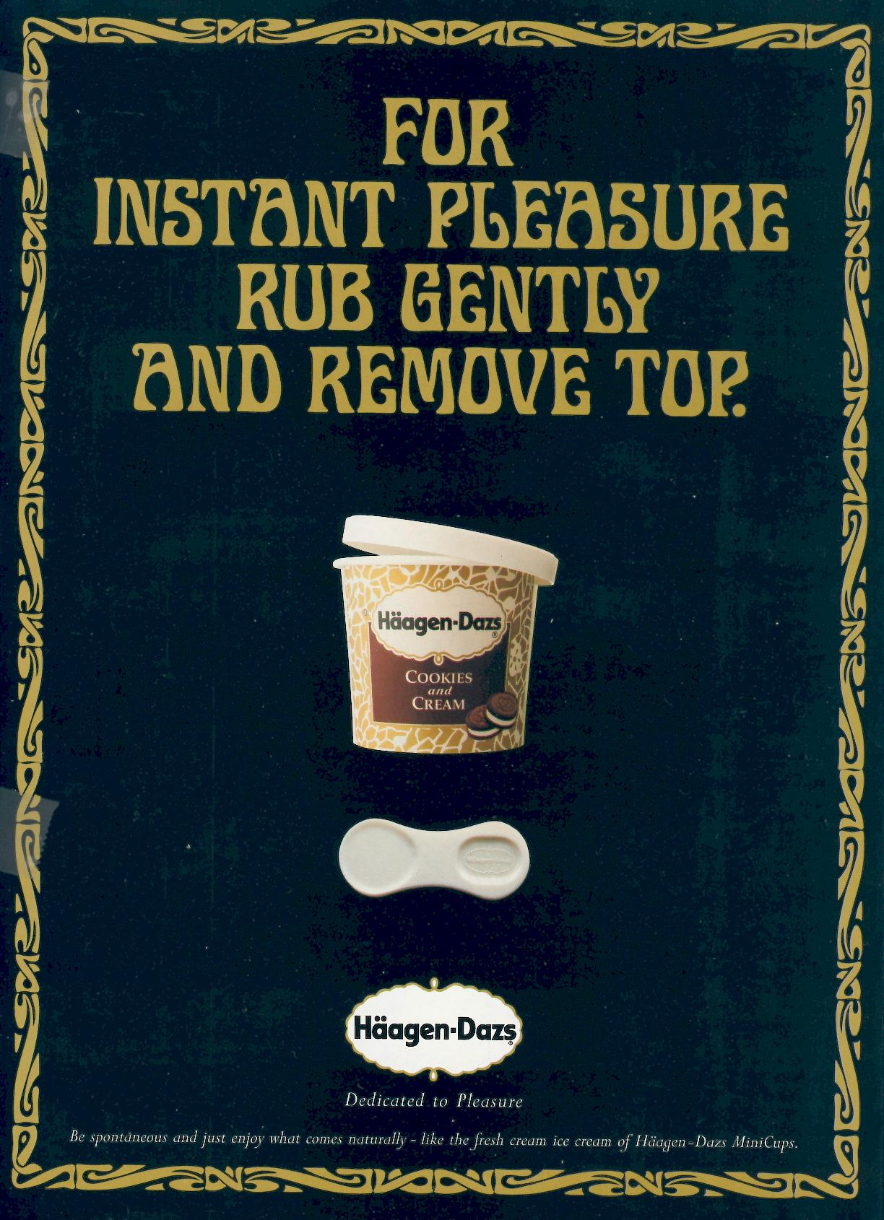
Long-term Orientation: Japan
Short-term Orientation: U.S.A.

Slide 21
Collectivism/Individualism & Short/Long Term Orientation Consequences for communication & media
Collectivist | Short-term orientation | Long-term orientation | Individualist
Intensive interpersonal communication | Oral communication, elaborate | Literate, preference for writing | Active information search
Social media = virtual family | Self-enhancement needs | Modesty | Individual preferences
Intensive use of social media | Preference for self-enhancing social media (Facebook) | Preference for anonymity | Information via search engines and media
Many personal contacts | Many friends in social media | Few friends in social media | Selective friendships

Slide 22
Ind/Col x LTO/STO world map (de Mooij)
Preoccupation with face
Anonymity
Few friends
social media
Modest, indirect expression
of competence
Privacy needs
Selective friendships social media
Active search for information
Use of search engines
Social media reinforce
community
Short-term orientation Long-term orientation
Social media reinforce uniqueness
Poland
Self enhancement
Social media virtual family
Many friends = status
Self enhancement; self disclosure,
Many friends, Facebook popular
Resource for information
Impression management
Positive self statements
Collectivism
Individualism

Slide 23
Power Distance: Rightful place vs equality
respect authority & elders
acceptance and expectance of authority
‘rightful place’, dependence,
roles and language depend on relative position
less newspaper reading, more TV watching
Power Distance
large
inequality minimized, anti-authority arguments, “critical mind” opinions
respect for youth, independence
more newspaper reading, less TV watching
Power Distance
small

Slide 24
Uncertainty Avoidance - Coping with ambiguity
Strong UA
Clarity, structure, precision
competence/expertise, scientific control
slow adoption of innovations
advertising is serious
Comfortable with ambiguity, chaos
fast adoption of innovations
more humor in advertising
Weak UA

Slide 25
UAI+: slower adoption of Internet
Uncertainty Avoidance
2002 % of population
without access to
Internet at home or
work r = .91
2007 % of population
who never use the Internet
apart from professional activity
r = .94
Sources: European Social Survey 2002; Eurobarometer: European cultural values, 2007

Slide 26
Intercultural Communication
Intercultural contacts, often violent, are as old as mankind
Successful nonviolent intercultural communication can be learned
Step 1: Awareness of the existence of cultural differences
Step 2: Knowledge about cultures involved, including one’s own
Step 3: Skills in communicating across different values, through developing shared practices

Slide 27
Examples of practices for intercultural communication
Symbols (words, gestures and objects whose meaning has to be learned): Trade languages like Swahili, and business pidgin Englishes
Heroes (persons, alive or dead, real or imaginary, who serve as models for behaviour): Intermediaries who gain the confidence of both sides
Rituals (shared activities that are technically superfluous but socially essential): Eating and drinking together, when, where and what

Slide 28
Success of intercultural communication depends on the personalities involved
Helpful personality characteristics:
Stability: strong personal tolerance for ambiguity
Openness to experience: curiosity for what is new
Language skills
Exposure to other cultures in childhood & adolescence

Slide 29
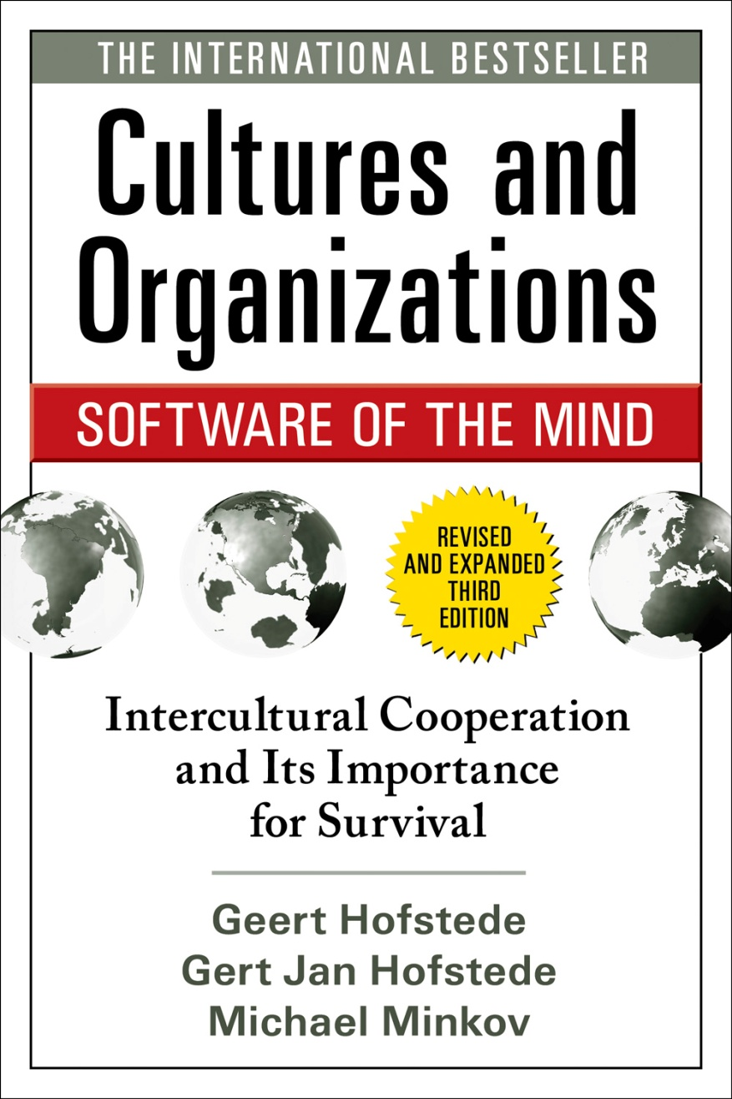
General reader book 2010 (2005, 1991)
Co-authors 3rd ed.:
Gert Jan Hofstede and
Michael Minkov
So far also available in Danish, Dutch, French, Polish, Romanian and Swedish; forthcoming in Japanese and Vietnamese.
Polish version:
Kultury i organizacje:
Zaprogramowanie umysłu
Previous editions available
In Bulgarian, Chinese, Czech, Finnish, German, Georgian, Hungarian, Japanese, Korean, Norwegian, Portuguese and Spanish
All information on website www.geerthofstede.eu
Academic book,
first published 1980
2nd re-written edition 2001
(600 pages, two columns)

Slide 30
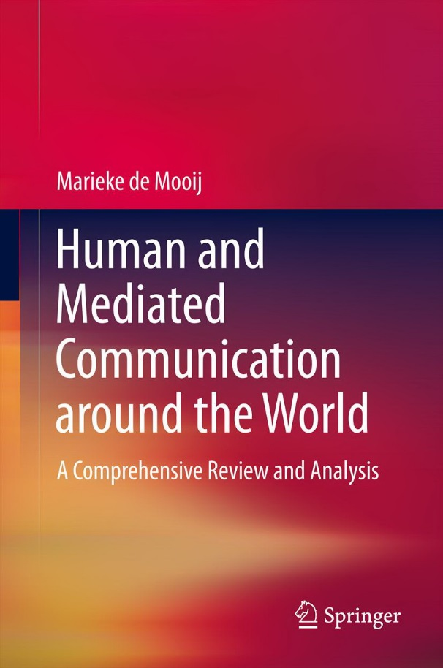
Marieke de Mooij (Dutch marketing expert)
Human and mediated communication around the world. A comprehensive review and analysis.
September 2013, both e-book and hardcopy
Springer International / SpringerLink
Non-ethnocentric textbook by same author:
Global Marketing and Advertising: Understanding Cultural Paradoxes
SAGE Publications, USA , 4th edition 2013

